Slide 1
Chapter 13 – Dependability Engineering
CSE 319
Software Engineering
Credit Hr. 3.00, Contact Hr. 3.00
Lec Tarannum Zaki
Dept of CSE
MIST

Slide 2
Topics covered
Redundancy and diversity
Dependable processes
Dependable systems architectures
Dependable programming

Slide 3
Regulated systems and dependability
Many critical systems are regulated systems, which means that their use must be approved by an external regulator before the systems go into service.
Nuclear systems
Air traffic control systems
Medical devices
A safety and dependability case has to be approved by the regulator.
Therefore, critical systems development has to create the evidence to convince a regulator that the system is dependable, safe and secure.

Slide 4
Diversity and redundancy
Redundancy and diversity are fundamental strategies for enhancing the dependability of any type of system.
Redundancy
Keep more than 1 version of a critical component available so that if one fails then a backup is available.
Diversity
Provide the same functionality in different ways so that they will not fail in the same way.
However, adding diversity and redundancy adds complexity and this can increase the chances of error.
Some engineers advocate simplicity and extensive V & V is a more effective route to software dependability.

Slide 5
Diversity and redundancy examples
Redundancy
Where availability and reliability is critical (e.g. in e-commerce systems), companies normally keep backup servers and switch to these automatically if failure occurs.
Diversity
To provide resilience against external attacks (e.g. defense organization), different servers may be implemented using different operating systems (e.g. Windows and Linux)

Slide 6
Dependable processes
To ensure a minimal number of software faults, it is important to have a well-defined, repeatable software process.
A well-defined repeatable process is one that does not depend entirely on individual skills; rather can be enacted by different people.
Regulators use information about the process to check if good software engineering practice has been used.
For fault detection, it is clear that the process activities should include significant effort devoted to verification and validation.

Slide 7
Attributes of dependable processes
Process characteristic | Description
Documentable | The process should have a defined process model that sets out the activities in the process and the documentation that is to be produced during these activities.
Standardized | A comprehensive set of software development standards covering software production and documentation should be available.
Auditable | The process should be understandable by people apart from process participants, who can check that process standards are being followed and make suggestions for process improvement.
Diverse | The process should include redundant and diverse verification and validation activities.
Robust | The process should be able to recover from failures of individual process activities.

Slide 8
Validation & Verification activities
Requirements reviews.
Requirements management.
Formal specification.
System modeling
Design and code inspection.
Static analysis.
Test planning and management.
Change management

Slide 9
Fault tolerance
In critical situations, software systems must be fault tolerant.
Fault tolerance is required where there are high availability requirements or where system failure costs are very high.
Fault tolerance means that the system can continue in operation in spite of software failure.
Even if the system has been proved to conform to its specification, it must also be fault tolerant as there may be specification errors or the validation may be incorrect.

Slide 10
Dependable system architectures
Dependable systems architectures are used in situations where fault tolerance is essential. These architectures are generally all based on redundancy and diversity.
Examples of situations where dependable architectures are used:
Flight control systems, where system failure could threaten the safety of passengers
Reactor systems where failure of a control system could lead to a chemical or nuclear emergency
Telecommunication systems, where there is a need for 24/7 availability.

Slide 11
Protection system architecture
A specialized system that is associated with some other control system, which can take emergency action if a failure occurs.
System to stop a train if it passes a red light
System to shut down a reactor if temperature/pressure are too high
Protection systems independently monitor the controlled system and the environment.
If a problem is detected, it issues commands to take emergency action to shut down the system and avoid a catastrophe.

Slide 12
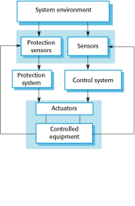
Protection system architecture

Slide 13
Protection system functionality
Protection systems are redundant because they include monitoring and control capabilities that replicate those in the control software.
Protection systems should be diverse and use different technology from the control software.
They are simpler than the control system so more effort can be expended in validation and dependability assurance.
Aim is to ensure that there is a low probability of failure on demand for the protection system.

Slide 14
Self-monitoring system architecture
Multi-channel architectures where the system monitors its own operations and takes action if inconsistencies are detected.
The same computation is carried out on each channel and the results are compared. If the results are identical and are produced at the same time, then it is assumed that the system is operating correctly.
If the results are different, then a failure is assumed and a failure exception is raised.

Slide 15

Self-monitoring system architecture

Slide 16
Self-monitoring system functionality
Hardware in each channel has to be diverse so that common mode hardware failure will not lead to each channel producing the same results.
Software in each channel must also be diverse, otherwise the same software error would affect each channel.
If high-availability is required, you may use several self-checking systems in parallel.
This is the approach used in the Airbus family of aircraft for their flight control systems.

Slide 17
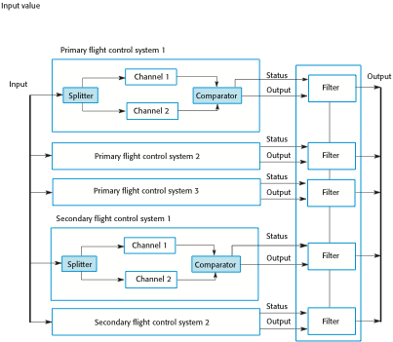
Airbus flight control system architecture

Slide 18
Good practice guidelines for dependable programming
Dependable programming guidelines 1. Limit the visibility of information in a program 2. Check all inputs for validity 3. Provide a handler for all exceptions 4. Minimize the use of error-prone constructs 5. Provide restart capabilities 6. Check array bounds 7. Include timeouts when calling external components 8. Name all constants that represent real-world values

Slide 19
THANK YOU

